Slide 1
Maximizing the reward in a Reinforcement Learning environment using Hybrid Intelligence System
Project By
Srinivas Rahul Sapireddy
C N Manirathinam

Slide 2
Hybrid Model
The Hybrid Model is a combination of different deep learning algorithms (The most powerful ones).
Convolutional Neural Network
Variational Autoencoder
Mixed Density Network
Recurrent Neural Network

Slide 3
Pros:
Most powerful AI model in Deep Reinforcement Learning
Offers large room for improvement

Slide 4
Cons:
Complex to understand
Very hard to implement
Highly Compute Intensive to Train

Slide 5
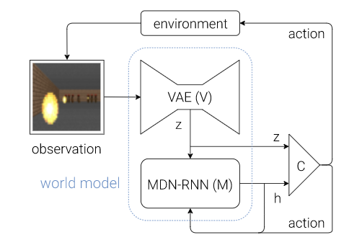
Model

Slide 6
The above hybrid model combines the following deep learning algorithms
Convolutional Neural Network: Allows the AI to see
Variational Autoencoder: Allows the AI to dream
Recurrent Neural Network with MDN: Allow AI to remember
Controller: To review the right actions to play in order to maximize the reward in the environment.
On top of that we have a powerful optimizer of deep neuro evolution which is evolution strategy.

Slide 7
LIBRARIES USED
conda create -n masterai python=3.6
conda activate masterai
conda install -c conda-forge tensorflow
python -n pip install cma
conda install -c anaconda mpi4py
conda install -c kne pybox2d
pip install pillow
pip install gym==0.9.4

Slide 8
Problems faced during installing libraries
Faced complex problems installing libraries of TensorFlow.
Open AI gym supports TensorFlow libraries less than 2.0 version for our Hybrid Model
Installing Box2D library.

Slide 9
TENSORFLOW
An interface for expressing machine learning algorithms.
Implementation for executing such algorithms.
A framework for creating ensemble algorithms for today’s most challenging problems. (Google Brain Team)

Slide 10
DIFFERENT FRAMEWORKS IN DEEP LEARNING
For beginners – Use Keras
For production on GCP – Use TensorFlow
For research – Use PyTorch
For production on AWS – Use MXNET
For production on Azure – Use CNTK
For Java Developers – Use DL4J
Chainer
For interoperability – Use ONNX

Slide 11
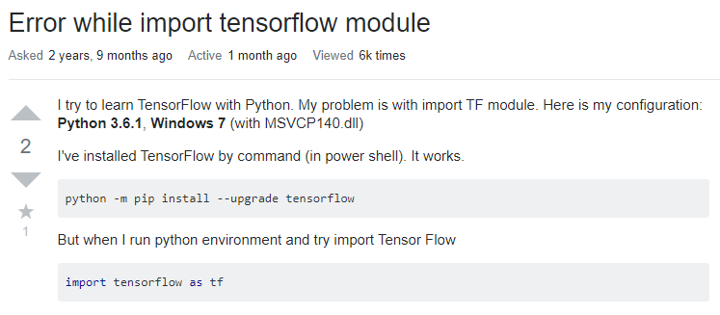
conda install -c conda-forge tensorflow

Slide 12
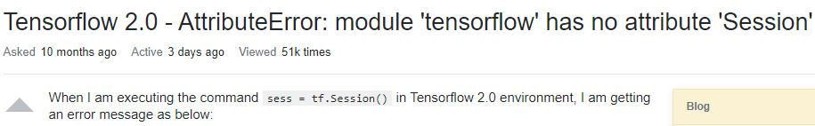
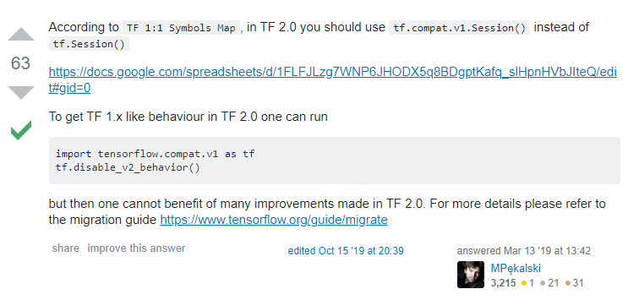
Problems Faced during execution

Slide 13
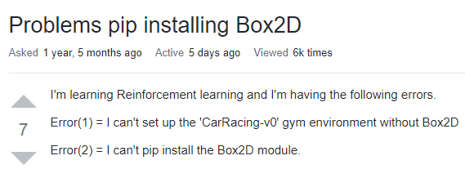
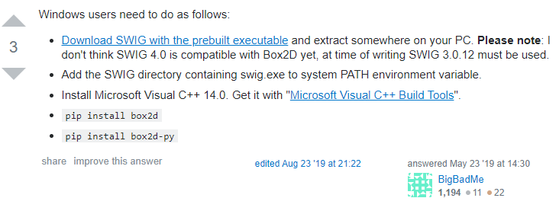
conda install -c kne pybox2d

Slide 14

PYBOX2D
2D Game Physics for Python
https://github.com/pybox2d/pybox2d
What is it?
pybox2d is a 2D physics library for your games and simple simulations. It's based on the Box2D library, written in C++. It supports several shape types (circle, polygon, thin line segments), and quite a few joint types (revolute, prismatic, wheel, etc.).

Slide 15
cma
CMA-ES Covariance Matrix Adaptation Evolution Strategy a stochastic numerical optimization algorithm for difficult (non-convex, ill-conditioned, multi-modal, rugged, noisy) optimization problems in continuous search spaces, implemented in Python.
Typical domain of application are bound-constrained or unconstrained
objective functions with:
search space dimension between 5 and 100, no gradients available, no less than, say, 100 times dimension function evaluations needed to get satisfactory solutions, non-separable, ill-conditioned, or rugged/multi-modal landscapes.
The CMA-ES is quite reliable, however for small budgets (fewer than 100 times dimension function evaluations) or in very small dimensions better methods are available.

Slide 16
mpi4py
Get a good scientific Python environment
By a “good Python environment”, I mean a recent version of Python with recent versions of the main packages for sciences installed (SciPy, NumPy, Matplotlib, IPython, h5py, etc.) and a good editor with fly checks.

Slide 17
PILLOW
What is PIL/Pillow?
PIL (Python Imaging Library) adds many image processing features to Python. Pillow is a fork of PIL that adds some user-friendly features.

Slide 18
OPEN AI GYM
OpenAI Gym is a toolkit for developing and comparing reinforcement learning algorithms. This is the gym open-source library, which gives you access to a standardized set of environments.
Gym makes no assumptions about the structure of your agent, and is compatible with any numerical computation library, such as TensorFlow or Theano. You can use it from Python code, and soon from other languages.

Slide 19
Gym Basics
There are two basic concepts in reinforcement learning: the environment (namely, the outside world) and the agent (namely, the algorithm you are writing). The agent sends actions to the environment, and the environment replies with observations and rewards (that is, a score).
The core gym interface is Env, which is the unified environment interface. There is no interface for agents; that part is left to you. The following are the Env methods you should know:
reset(self): Reset the environment's state. Returns observation.
step(self, action): Step the environment by one timestep. Returns observation, reward, done, info.
render(self, mode='human'): Render one frame of the environment. The default mode will do something human friendly, such as pop up a window.

Slide 20
Output Description
Using this hybrid intelligence system, we can play against AI. Here we can see the competition of human intelligence vs artificial intelligence.
Here we have our car and AI will also have its own car and it will try to drive as fast as possible for 30 seconds. The faster it drives, the further it gets, the maximum score it will get.

Slide 21
Resources
https://worldmodels.github.io/
1
http://blog.otoro.net/2017/10/29/visual-evolution-strategies/
2
https://magenta.tensorflow.org/sketch-rnn-demo

